Slide 1
Exploratory Data Analysis of Regional Sales
Shobana Ramakrishnan

Slide 2
Problem Statement
Sales teams often lack a clear, data-driven understanding of regional performance, making it difficult to identify growth opportunities and optimize resources. This project aims to analyse and visualize regional sales data to uncover trends, evaluate profitability, and support strategic decision-making.

Slide 3
Approach
Explore & define goals: Understand each sheet, their connections, and what insights we want (top products, sales trends, profitable channels). Prepare data: Load libraries, import sheets as dataframes, and merge them into a single dataframe. Overview : Inspect data and and extract new columns like month and year Analyze patterns: Perform EDA to find trends, peaks, and relationships across products, regions, and time

Slide 4
Data Overview
The dataset contains six sheets, one for each year from 2014 to 2018, showing regional sales data.
Each sheet lists sales transactions with information about the product, customer, region, quantity sold, price, and profit.
Additional tables provide details about products, customers, and regions.
Budget information is included for products and regions, allowing comparisons between planned and actual sales.
Geographic information helps analyze sales by state or region.

Slide 5
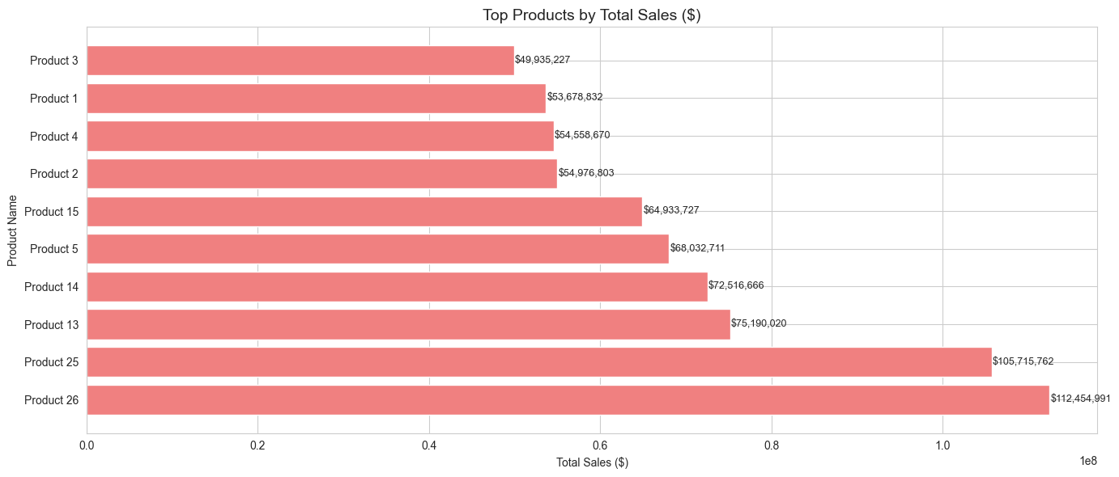
Exploratory Data Analysis
Top 10 SKUs by Sales
Product 26 and 25 dominate with sales above $100M each (26 leads at $112M).
Sharp revenue gap after the top 2; next best SKU (Product 13) lags at $75M.
Mid-tier cluster: Products 3, 1, 4, and 2 hover around $50M–$55M.
Lower tier within top 10: Products 15, 5, 14, and 13 trail significantly.
Revenue concentration: Top 10 SKUs drive a large share of total sales, showing dependency on few products.
Long-tail effect: SKUs outside the top 10 contribute marginally to overall revenue.

Slide 6
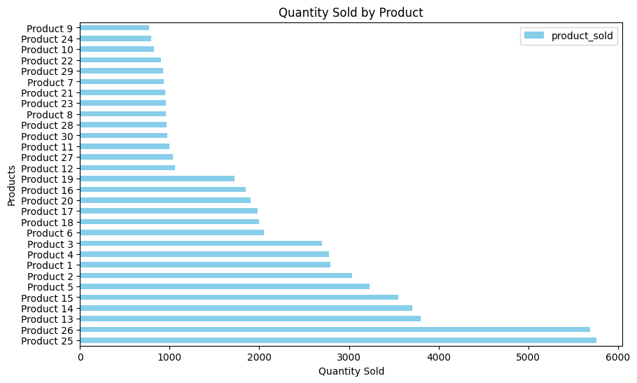
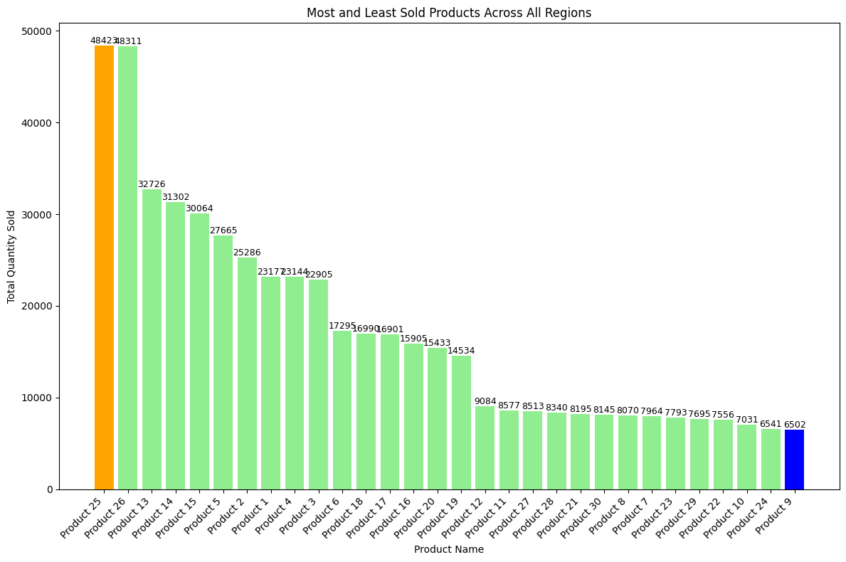
Exploratory Data Analysis
Quantity Sold by Product (Horizontal Bar Chart) Clear dominance: Products 25 & 26 surpass 5,500 units, creating a wide gap versus other SKUs. Skewed distribution: Majority of products fall below 2,000 units, showing uneven contribution. SKU risk: Heavy dependence on 2 products poses risk if demand shifts. Operational impact: Longtail SKUs may require higher storage costs relative to their sales volume. Actionable: Consider demand forecasting & lean inventory for low-volume products.
Most & Least Sold Products Across Regions Products 25 & 26 maintain dominance regionally, indicating consistent nationwide appeal. Secondary group: Products 13, 14, and 15 show solid but regionally varied sales strength. Product 9 lowest at 6,500 units signals either weak customer demand or poor availability. Huge performance gap (48,000 vs 6,500 units) underscores portfolio imbalance. Actionable: Audit regional marketing, distribution, and shelf placement for low performers.

Slide 7
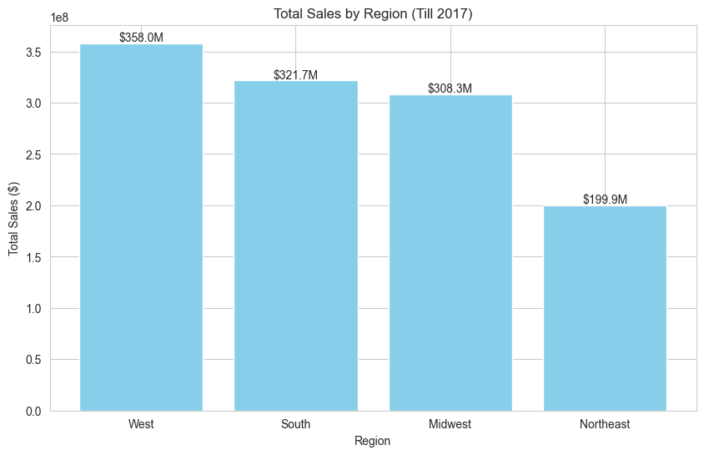
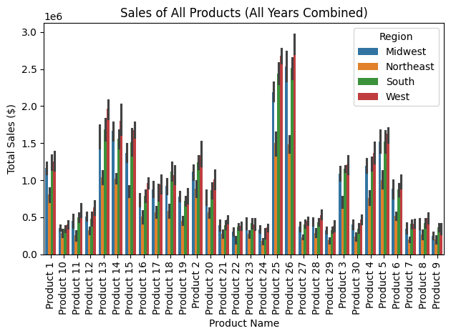
Exploratory Data Analysis
Total Sales By Region : West region is the top performer with $358M in sales. South ($322M) and Midwest ($308M) follow closely, indicating strong market demand. Northeast ($200M) significantly lags, highlighting agap in sales performance. Differences in regional sales suggest variation in market size, customer demand, or effectiveness of sales strategies.
Sales of All Products: Top Products: Product 25 & 26 lead with ~$2.6M–$3.0M per region, driving most revenue. Regional Performance: West (~$3M) and South are strongest; Midwest slightly lower; Northeast lowest (~$2.6M–$2.7M). Mid-Tier Products: Products 13–15 generate ~$1.7M–$2.1M per region, ~30–40% below top products. Low Performers: Product 9 and others <$0.5M per region; many products under $1M. Takeaways: Focus on Products 25 & 26 in West/South; boost mid-tier products in Northeast/Midwest; review low performers.

Slide 8
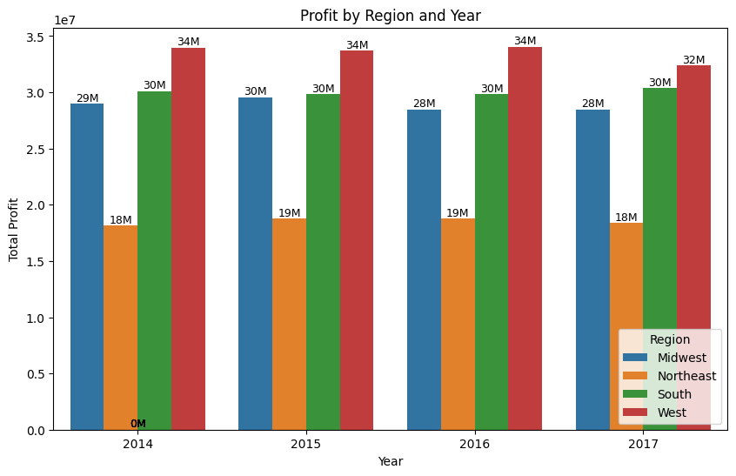
Exploratory Data Analysis Profit by Region and Year:
West Region: Highest profit every year, peaking at $34M (2014–2016), slightly lower at $32M in 2017. South Region: Consistent profit around $30M each year, stable performance. Midwest Region: Profit ranges from $28M–$30M per year, slightly declining in 2016–2017. Northeast Region: Lowest profit, between $18M–$19M per year, with a small dip in 2017.
Trends West region dominates in profit, outperforming all other regions by $2M–$6M annually. South and Midwest are close, but South is slightly ahead. Northeast consistently lags behind, with profits $10M–$16M lower than West.Profits are stable for most regions, with only minor fluctuations year to year.

Slide 9
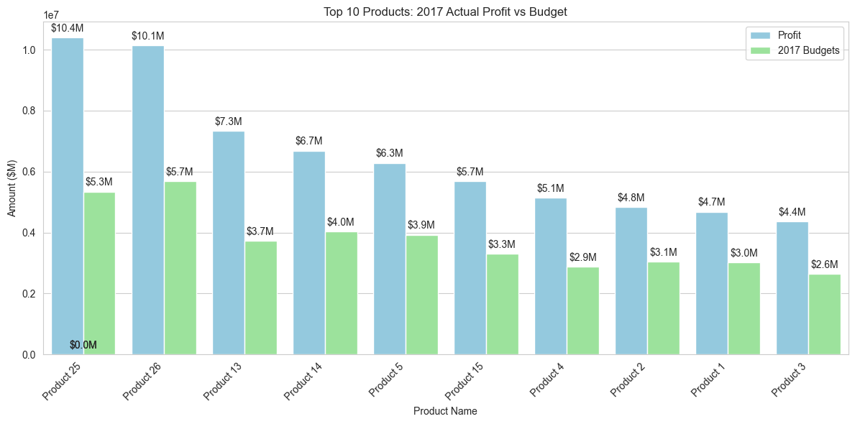
Exploratory Data Analysis
Top 10 Products: 2017 Profit vs Budget:
Key Insight:
Products 25 & 26: Actual profit ~$10.4M & $10.1M vs budget ~$5.3M & $5.7M nearly double the budget. Products 13 & 14: Also exceeded budget significantly ($6.7M–$7.3M actual vs $3.7M–$4.0M budget).
Top 10 products all outperformed budget, with profits 60–100% above expectations.
Actionable Takeaways: Prioritize Products 25 & 26: most profitable and consistently outperforming. Revise budgets upward for high-performing products next year. Allocate resources to other top performers (13, 14, 5, 15) to maintain or grow profit. Summary: Strong sales and/or cost management drove profits well above budget, especially for top SKUs, highlighting the importance of focusing on these products in strategy and resource allocation

Slide 10
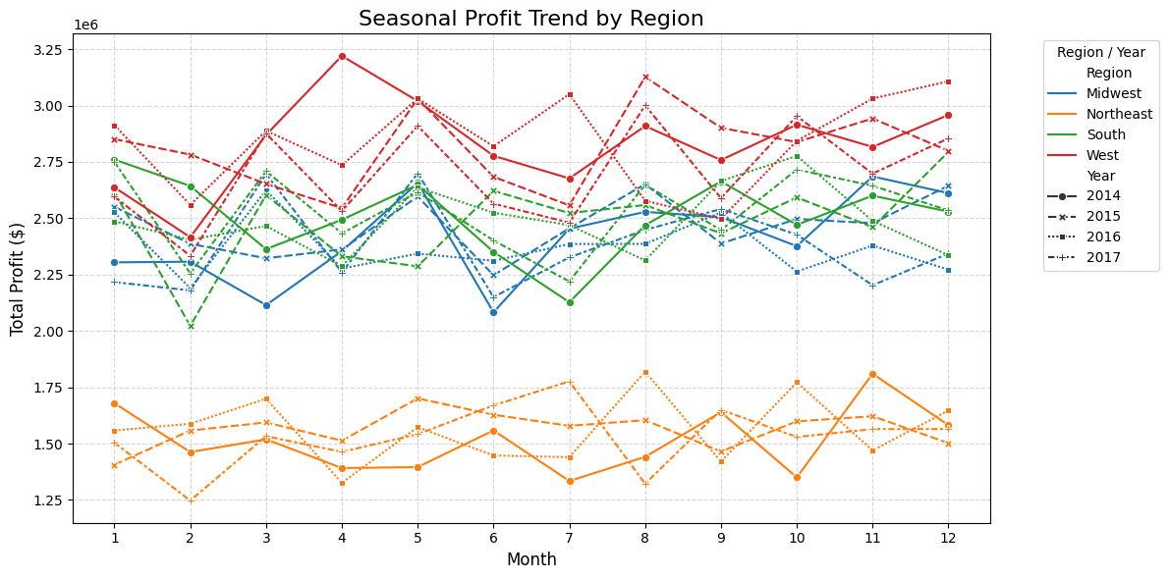
Exploratory Data Analysis
Seasonal Profit Trend Profit (2014–2017) West Region: Consistently highest monthly profit ($2.4M–$3.25M), peaking in April, May, August, and December. 2017 is the strongest year. South Region: Profits range $2.1M–$2.7M, slightly upward trend in 2017; moderate seasonality with peaks in May & November. Midwest Region: Profits $2.1M–$2.7M; 2017 shows improvement, minor dips in February & June. Northeast Region: Lowest monthly profits ($1.3M–$1.75M), flat across years; minimal seasonal variation. Seasonal & Yearly Trends: West shows strongest seasonal peaks and YoY growth; South & Midwest stable; Northeast stagnant. Actionable Takeaways: West: Invest in marketing & inventory during peak months (spring, late summer). South & Midwest: Target strategies for low-profit months (Feb, June) to boost performance. Northeast: Implement targeted interventions—new products, promotions, or operational improvements. Budgeting: Use 2017 monthly data as a benchmark, especially for West.

Slide 11
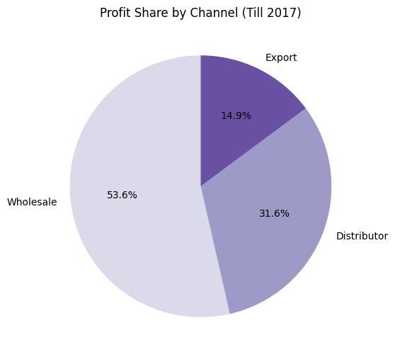
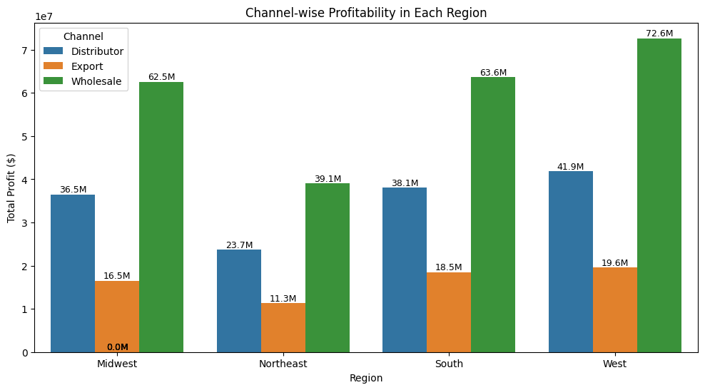
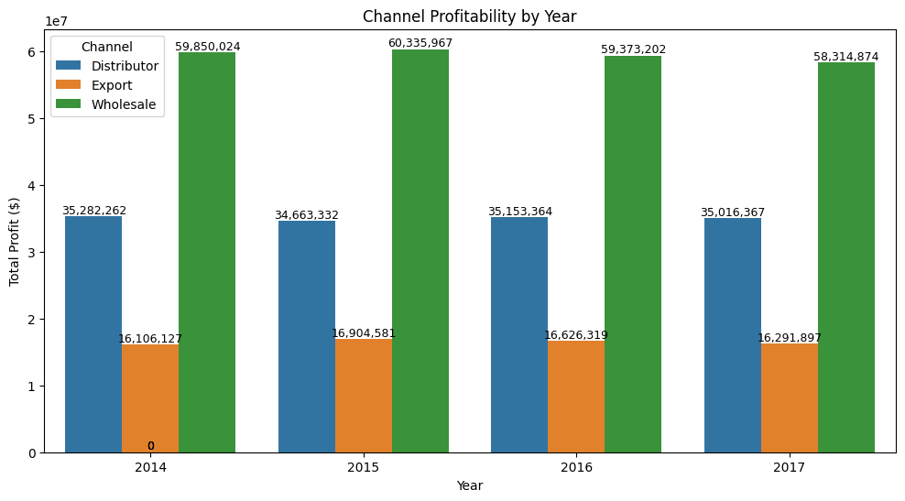
Exploratory Data Analysis
Channel Profitability
Wholesale dominates profit with 53.6% share, leading in every region, especially West ($72.6M).
Distributor is stable at 31.6% of profit, second-highest across all regions and years.
Export underperforms (14.9%), lowest profits across regions ($11.3M–$19.6M), requiring review.
Channel performance is consistent year-over-year; focus on Wholesale and West for maximum , with targeted strategies for Export and Distributor.

Slide 12
Key Insights
West region leads with $358M revenue (36%) and $34M annual profit; Northeast lags at $200M revenue.
South ($322M) and Midwest ($308M) perform steadily, with minor seasonal dips, while Northeast shows minimal growth.
Products 25 & 26 dominate sales, $112M & $100M, nearly double 2017 profit budgets (Product 25: $10.4M vs $5.3M).
Top 10 SKUs drive 70% of revenue, mid-tier products 13–15 contribute $6–7M; long-tail SKUs < $0.5M.
Quantity sold Products 25 & 26 >5,500 units; most other SKUs <2,000 units.
Wholesale channel contributes 53.6% of total profit, especially in West ($72.6M); Distributor 31.6%, Export 14.9% ($11.3–$19.6M).
West peaks Apr/May, Aug, Dec; South & Midwest minor peaks; Northeast flat; 2017 strongest year.
Actionable focus: Prioritize Products 25 & 26, West region, and Wholesale; boost mid-tier products in Midwest/South; target Northeast & Export with strategic initiatives.

Slide 13
Recommendations
Focus on Flagship Products: Invest in Products 25 & 26—highest sales and profit performance.
Leverage Wholesale Channel: Strengthen the primary profit driver (53.6% of total profit).
Review Export Channel: Optimize or reallocate resources from the underperforming Export channel.
Invest in West Region: Continue growth initiatives in the top-performing West region ($358M sales, $34M profit).
Turnaround Northeast: Implement strategies to boost sales and profit in the underperforming region.
Optimize Product Portfolio: Discontinue low-volume/low-profit SKUs; nurture mid-tier winners (Products 5, 13, 14).
Align Marketing Seasonally: Use seasonal campaigns in the West and Q1 promotions in South & Midwest.
Strengthen Customer Relationships: Secure top clients and upsell mid- and lower-tier customers.

